Slide 1
Heart Disease Indicators Analysis
Team 4
Xin Ma: 001021916
Wenzhuo Wang: 001562172

Slide 2
Overview
This project is based on the heart health indicators data scraped from BRFSS(Behavioral Risk Factor Surveillance System) provided from kaggle, during 2015.
The focus will be on the relationship between heart diseases (including CHD and MI) and multiple potential factors, and provide quantitative health suggestions according to the research.

Slide 3
Data sources
Dataset: https://www.kaggle.com/alexteboul/heart-disease-health-indicators-dataset
Dataset for heart health indicators, contains of one data file:
heart_disease_health_indicators_BRFSS2015.csv contains 22 columns and 250k rows of heart health indicators.
Significant features: heartdisease, HighBP, HighChol, BMI, Smoker, Stroke, Diabetes, PhysActivity, Fruits and etc.

Slide 4
Goals
Analyze heart health indicator data to understand the correlation with heart disease, symptoms and other factors like living habits.
Make a logistic regression model to meet the data
Results for all the information is comprehensible

Slide 5
Use Cases
Users can get indicators summarizations based on different factors.
Users can get health recommendation(diet, exercise, etc.) to reduce the probability of coronary heart disease and myocardial infarction
After inputting relevant factors, users can obtain the probability of heart disease in this case

Slide 6
Methodology
Data Preprocessing & Visualization
Explore and clean the dataset using Spark
Analyze the features and show the diagrams
Spark
Correlation analysis and logistic regression will be completed on spark
Logistic Regression Model (cont.)
Use and logistic regression model to predict heart disease possibility based on other features

Slide 7
Progress
Nov 8 – Nov 14
Define the scope and framework of the project
Data Preprocessing & Visualization
Nov 15 – Nov 21
Build models and train data, using Spark SQL
Nov 22 – Nov 28
Evaluate and optimize model
Build User Interface with Play framework
Nov 29- Dec 5
Complete report and prepare for final presentation

Slide 8
OUR PROCESS IS EASY
Data Acquisition and Preprocessing
Build Model and Train Data
Test and Predict

Slide 9
Data Acquisition and Preprocessing
1

Slide 10
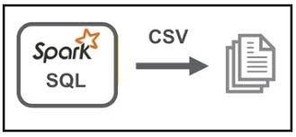
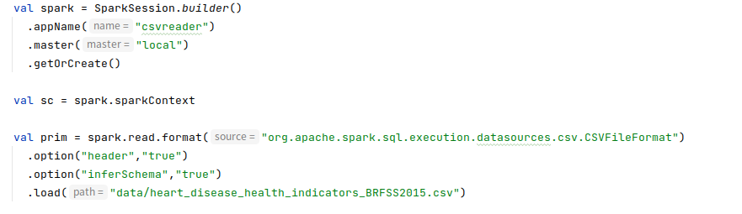
Read csv file using Spark SQL
Load heart disease csv file from Spark SQL
Prim = original csv data file

Slide 11
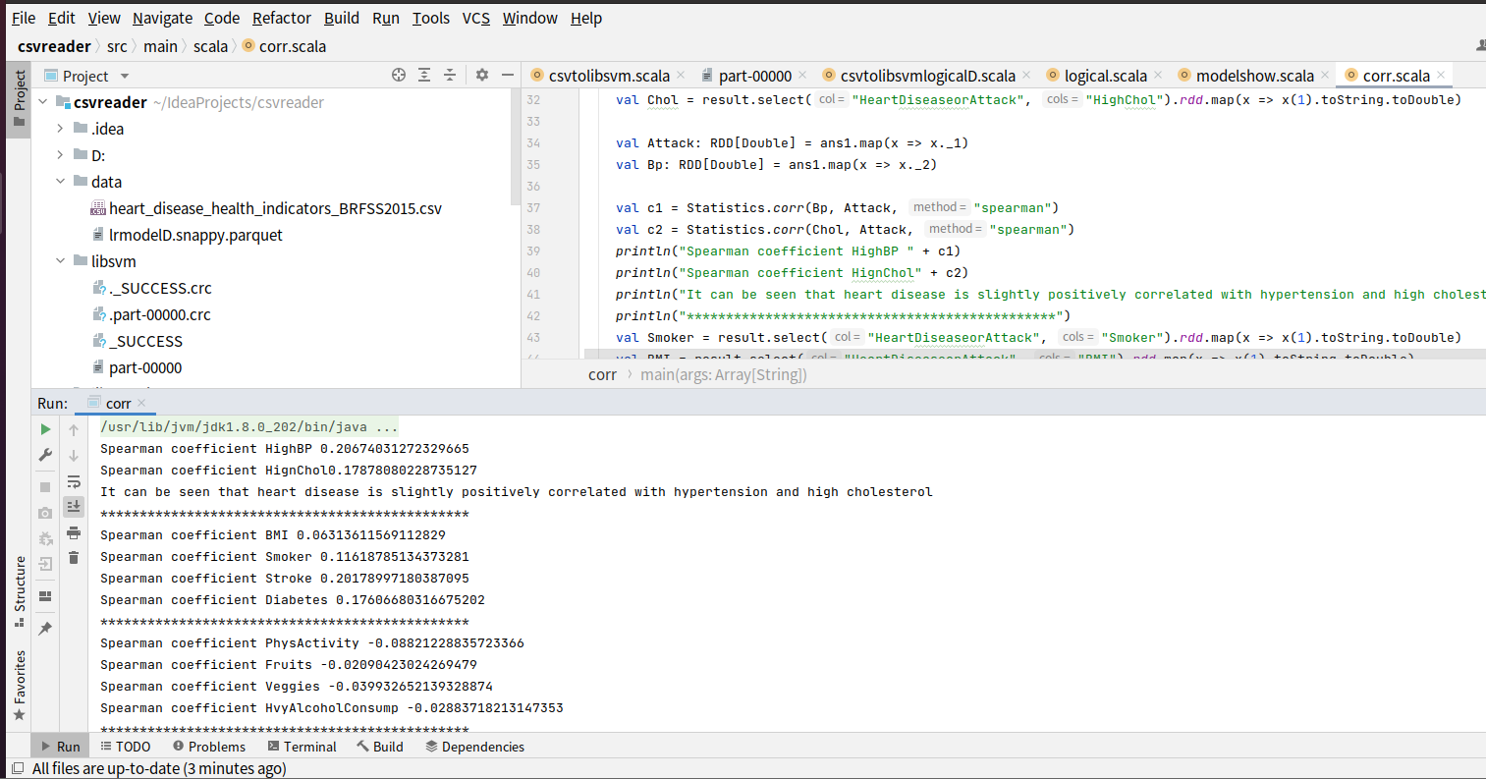
Statistic Corr File
For the preprocessing of these data, in addition to adding all features (21 items), we can also determine the feature quantities by analyzing the data with spearman correlation.

Slide 12
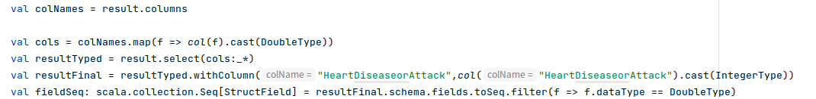
Prioritize Data
Since HighChol is always 0 when CholCheck is 0 (the cholesterol check is not done) and delete the data whose CholCheck is 0
Set HeartDiseaseorAttack to integer, and the rest to double to facilitate the distinction between label and features

Slide 13
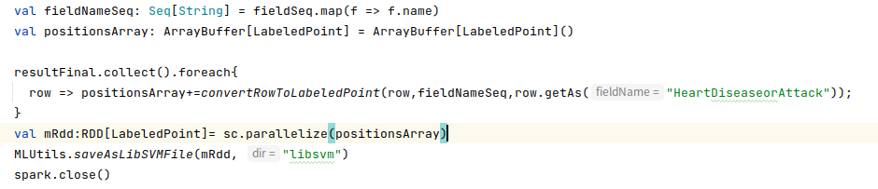
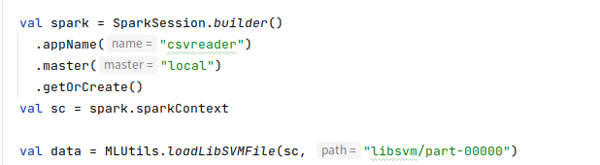
Convert Format and Save in Folder
Convert to LabeledPoint format and save it in the libsvm folder (libsvm/part-00000 is the required .libsvm file)
In the logicalwithLBFGS.scala file, first read the libsvm file

Slide 14
What is libsvm Format File
Libsvm is a file format used for methods such as support vector classification and logistic regression
Classification class is something like true/false; 0,1,... Here you need to transform it into integers (e.g. 0,1).
Feature space is a space for your multidimensional data. Each feauture (vector) should have its own ID (index) and its value. E.g. 1:23.2 means that feature/dimension 1 has value 23.2

Slide 15
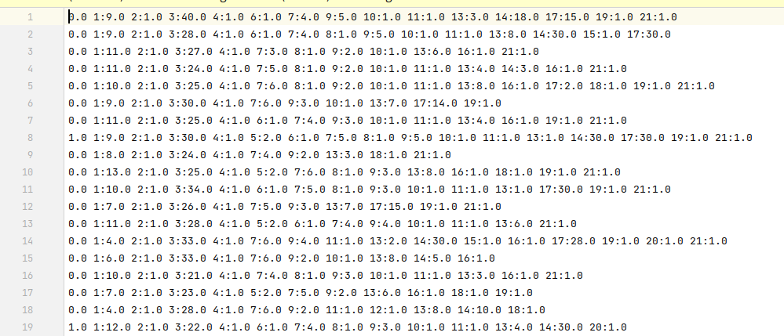
Libsvm Example
The first line is the label value, and and each column after that is the number of
columns: characteristic value

Slide 16
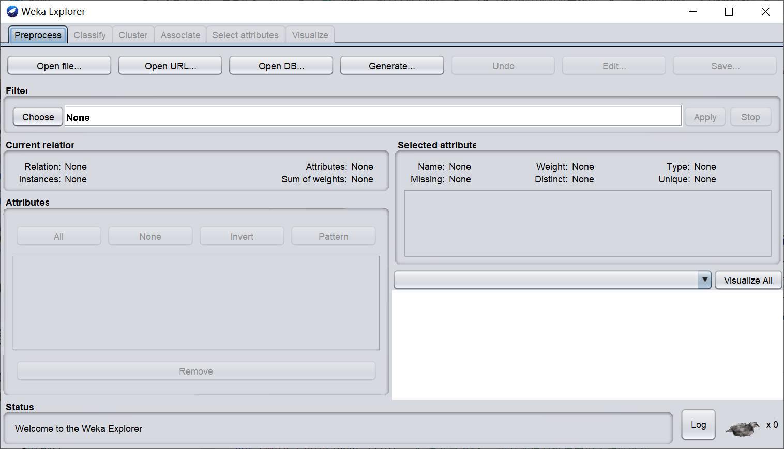
Libsvm Example
We usually use methods such as Weka explorer or Python to convert data formats such as csv to libsvm format (Weka explorer screenshots are shown below)

Slide 17
Use of Libsvm Format File
We use Labeledpoint format to convert to libsvm file, the steps are as follows:
make sure the feature column is set to Double Type and the target is Int
Iterate through each row and keep each value> 0 in one array
keep the index of its column in another array and convert to RDD[LabeledPoint] , then save RDD in libsvm format

Slide 18
Build Model and Train Data
2

Slide 19
Introduce Logistic Regression
Logistic regression is a popular method to predict a categorical response. It is a special case of Generalized Linear models that predicts the probability of the outcomes.
In spark.ml logistic regression can be used to predict a binary outcome by using binomial logistic regression.
Use the family parameter to select between these two algorithms, or leave it unset and Spark will infer the correct variant.

Slide 20

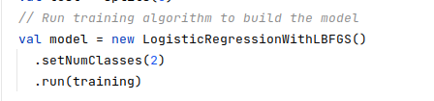
Training Set and Test Set
Randomly divide data into training set and test set
To ensure that the model is effective, We expect to increase the proportion of the training set to improve the pass rate of the test set
Generate a logistic regression model and train with the training set

Slide 21
Test and Predict
3

Slide 22
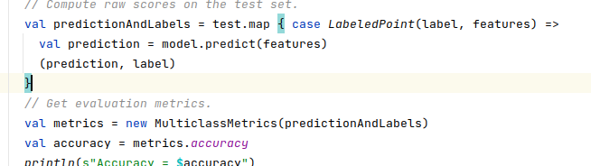

Test The Model
Test and output accuracy
Save the model

Slide 23
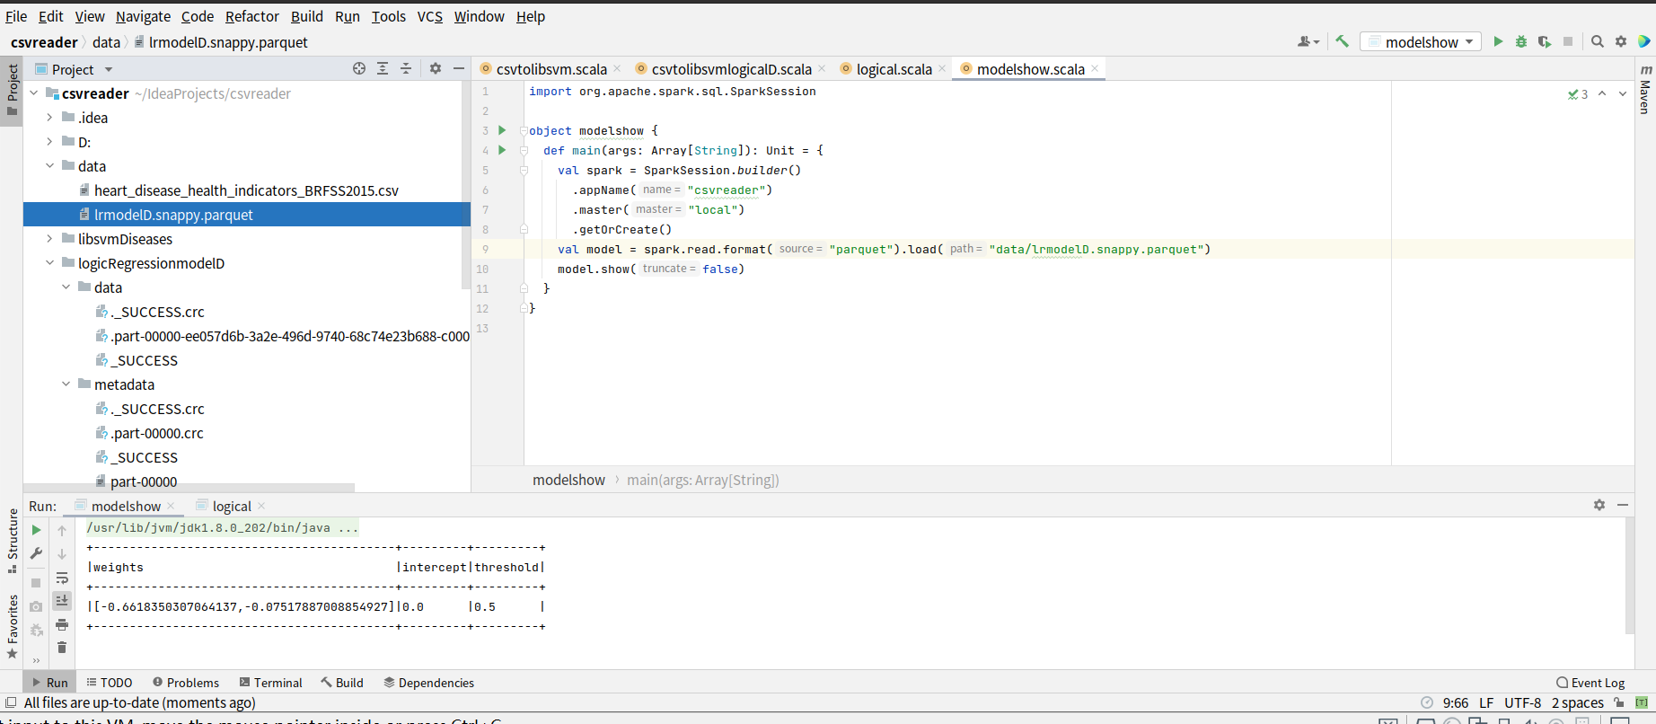
Diseases Logistic Regression Model Results
In order to improve efficiency， so we need to reduce the number of features, such as studying the effects of Stroke and Diabetes on HeartDiseases
The right picture shows that two columns required for filtering when obtaining data: Stroke and Diabetes

Slide 24
Acceptance Criteria
1. To get summarizations
Data Preprocessing and convert data format file
2. To get related coefficient
Calculate spearman correlation
3. To get trend predictions
The accuracy of training models should be higher than 80%

Slide 25
Workspace
Code Language and Framework:
Spark, ScalaGit Repo Link: https://github.com/Essexwwz/heart-health-indicator

Slide 26
Reference
https://stackoverflow.com/questions/45992227/scala-spark-converting-zero-inflated-data-in-dataframe-to-libsvm?rq=1
https://spark.apache.org/docs/latest/mllib-linear-methods.html#classification
https://spark.apache.org/docs/latest/ml-classification-regression.html#logistic-regression

Slide 27
THANKS!
Any questions?

